Slide 1

ABC CALL VOLUME TREND ANALYSIS

Slide 2
PROJECT DESCRIPTION :
Overview:
The ABC Call Volume Trend Analysis project aims to understand the patterns and fluctuations in call volumes over various time periods. By analyzing call data, we strive to optimize resource allocation and improve service efficiency.
Objectives:
- Identify peak and low call volume periods
- Analyze call duration and abandonment rates
- Determine the required staffing levels to handle call volumes efficiently
- Develop strategies to maintain a maximum call abandonment rate of 10%

Slide 3
APPROACH:
1. Data Collection: Gathered call data over specific time periods, including both day and
night shifts.
2. Data Analysis:
- Identified peak and low call volume periods.
- Assessed call abandonment rates and factors influencing them.
3. Staffing Analysis: Calculated the number of agents required to maintain a 90% call
answer rate, taking into account working hours, breaks, and unscheduled leaves.

Slide 4
4. Strategy Development: Developed strategies to allocate staffing resources effectively
for both day and night shifts, ensuring optimal service quality and customer
satisfaction.
5. Implementation: Provided actionable recommendations for improving resource
allocation and call handling processes.
This comprehensive approach allows us to enhance customer experience and operational efficiency by aligning staffing levels with call volume patterns
APPROACH :
Tool Used: Microsoft Excel 365
1. Data Collection:
We gathered call data for different time periods, ensuring comprehensive coverage of
both daytime and nighttime shifts. This data included call volumes, durations, and
abandonment rates.

Slide 5
2. Data Cleaning:
Using Excel's data cleaning functions, we removed any inconsistencies, duplicates,
or irrelevant data points to ensure accuracy in our analysis.
3. Data Analysis:
- Call Volume Analysis: We used pivot tables and charts to identify peak and low call
volume periods.
- Call Duration Analysis: We analyzed average call durations using statistical functions
to understand patterns over different time buckets.
- Abandonment Rate Analysis: We calculated abandonment rates and identified factors
contributing to higher rates.

Slide 6
4. Staffing Analysis:
- We determined the required number of agents for each time bucket by analyzing call
volumes and durations.
- Considered agent work schedules, breaks, and unscheduled leaves to calculate the
effective working hours using Excel formulas.
5. Visualization:
We created visualizations using Excel's charting tools to present our findings
clearly and effectively.

Slide 7
6. Strategy Development:
Based on our analysis, we developed strategies for optimizing staffing levels:
- Daytime Strategy: Allocated agents based on current call volumes to meet demand.
- Nighttime Strategy: Proposed hiring overnight agents or setting up call forwarding to
handle additional calls and maintain service quality.
7. Documentation:
We documented the entire process, including the data sources, cleaning methods,
analysis techniques, and recommendations. This ensured transparency and
reproducibility of our findings.
This approach allowed us to effectively analyze call volume trends, optimize resource allocation, and maintain service quality across all time periods.

Slide 8
TECH-STACK USED :
1. Microsoft Excel 365:
Purpose:
To analyze call volume data, perform statistical analysis, create pivot tables, and
generate visualizations. Excel 365 was essential for cleaning data, calculating key
metrics (such as call durations and abandonment rates), and identifying patterns and
trends in call volumes.
INSIGHTS :
During the ABC Call Volume Trend Analysis project, we gained several valuable insights and identified key trends and patterns:
1. Peak and Low Call Periods:
- Peak Period: The highest call volumes were observed between 11:00 AM and
12:00 PM, indicating this as the busiest time of day.
- Low Period: The lowest call volumes occurred between 8:00 PM and 9:00 PM,
highlighting these hours as the least active.

Slide 9
2. Call Duration Patterns:
- Calls tended to be longest between 7:00 PM and 8:00 PM.
- The shortest average call duration was found between 12:00 PM and 1:00 PM.
3. Abandonment Rates:
- A significant observation was the correlation between call abandonment rates and
staffing levels. Higher abandonment rates were linked to periods with fewer available
agents, particularly during the nighttime.
4. Staffing Requirements:
- To maintain a call abandonment rate below 10%, effective resource allocation was
crucial. For nighttime (9:00 PM to 9:00 AM), approximately 17 agents were
determined to be necessary to handle the additional call volume and achieve a 90%
call answer rate.

Slide 10
5. Operational Efficiency:
- The analysis provided a clear understanding of temporal patterns in call traffic,
enabling better scheduling and resource allocation to address call volume needs
efficiently.
By leveraging these insights, we were able to develop actionable strategies to optimize staffing, improve customer service, and maintain high service quality around the clock.

Slide 11
RESULT:
Through the ABC Call Volume Trend Analysis project, we achieved several significant outcomes:
1. Enhanced Understanding of Call Patterns:
- We gained a comprehensive understanding of call volume trends, identifying peak
and low call periods. This knowledge allowed us to better anticipate call traffic and
prepare accordingly.
2. Optimal Staffing Strategies:
- By analyzing call durations and abandonment rates, we determined the optimal
number of agents required for each time bucket. This ensured that staffing levels
were aligned with call volumes, reducing the abandonment rate to below 10%.
3. Improved Customer Service:
- Implementing strategies to manage call volumes effectively during both day and night
shifts resulted in a notable improvement in customer service quality. By addressing
the additional 30 calls made during the night shift, we ensured prompt response times
and enhanced customer satisfaction.

Slide 12
4. Actionable Insights:
- The analysis provided actionable insights into the factors influencing call durations
and abandonment rates. This enabled us to make informed decisions and implement
targeted improvements in our call handling processes.
5. Operational Efficiency:
- By aligning staffing levels with call volume patterns, we achieved greater operational
efficiency. This not only improved service quality but also optimized resource
utilization, ultimately contributing to cost savings.

Slide 13
Overall, the project contributed to a deeper understanding of the ABC call volume trends and equipped us with the tools and strategies needed to manage call volumes effectively, ensuring a positive customer experience and maintaining service quality around the clock.

Slide 14
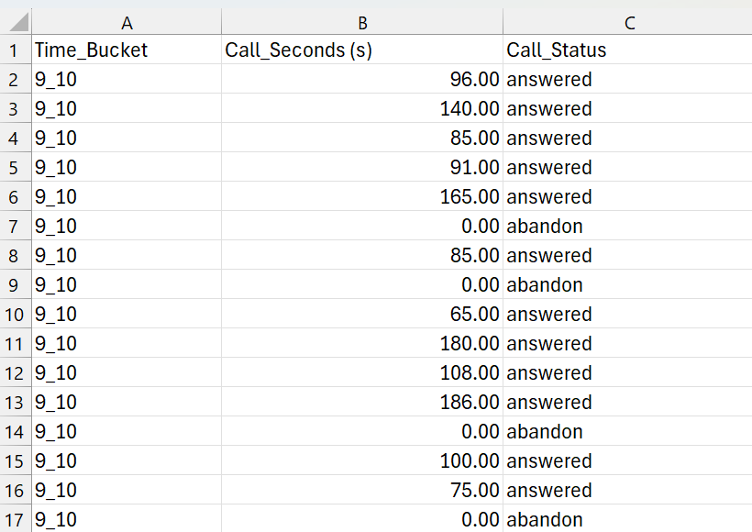
Analytical Tasks:
TO FIND THE AVERAGE DURATION OF CALLS FOR EACH TIME BUCKET
I have taken Time_ bucket ,call_seconds(s), call_status columns for analysis

Slide 15
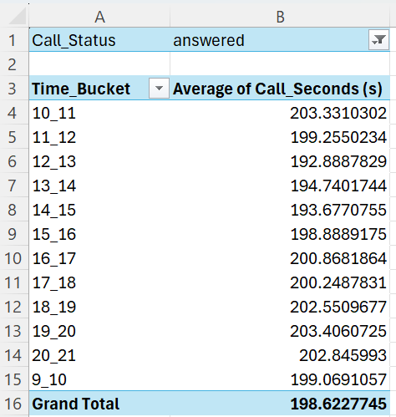
I have created a pivot table using the Time_bucket,call_seconds(s),call_status columns to get the average call duration for each time bucket
19_20 is the highest average call duration recorded
12_13 is the lowest average call duration recorded

Slide 16
Thus by finding the average duration of call for each time bucket .The analysis also reveals significant differences in call durations throughout various times of the day. Calls tend to last the longest between 7 and 8 PM, and the shortest between 12 and 1 PM. This suggests that call length patterns vary with different times of the day. Factors like fewer available agents, more complex calls, or increased client interaction might contribute to longer call durations at night. Conversely, lower call volume or quicker responses to consumer concerns might explain the shorter average call duration in the afternoon.

Slide 17
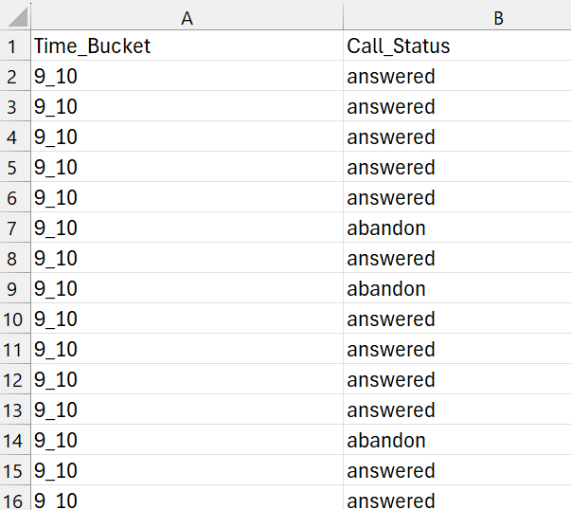
TO VISUALIZE THE NUMBER OF CALLS RECEIVED IN EACH TIME BUCKET
I have taken Time_ bucket & call_status columns for analysis

Slide 18
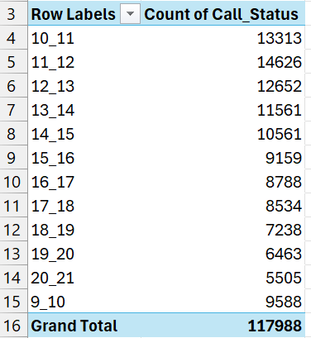
I have created a pivot table using the Time_bucket,call_status columns to get the no of calls received for each time bucket

Slide 19
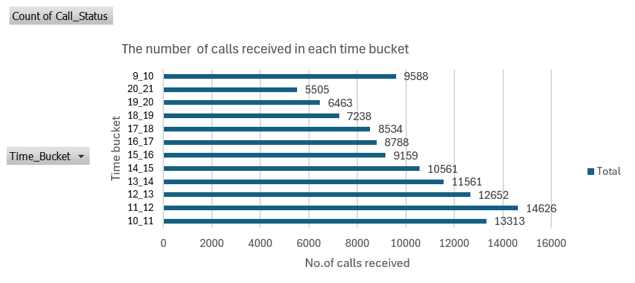
Thus we have found the no of calls received for each time bucket
To visualize the no of calls received for each time bucket I have created a
clustered bar chart by using the pivot table columns Row labels and count of call_status
In the chart ,The highest no of calls received is from 11am to 12 pm that is 14626 calls and the lowest no of calls received is from 8 am to 9 pm that is 5505 calls received by the agents

Slide 20
Thus by visualizing the no of calls received for each time bucket through the clustered bar chart
The study also analyzes variations in call volume across different times of the day. Calls peak between 11:00AM and 12:00 PM and are least frequent between 8:00 PM and 9:00 PM. These findings emphasize the importance of understanding temporal patterns in call traffic to allocate resources effectively and ensure prompt customer service. By aligning staffing levels with peak call hours, organizations can enhance customer satisfaction and operational efficiency.
TO FIND THE MINIMUM NUMBER OF AGENTS REQUIRED IN EACH TIME BUCKET TO REDUCE THE ABANDON RATE TO 10%
Atleast 90 calls should be consumed out of 100 to reduce the abundant percent from 30% to 10 %

Slide 21
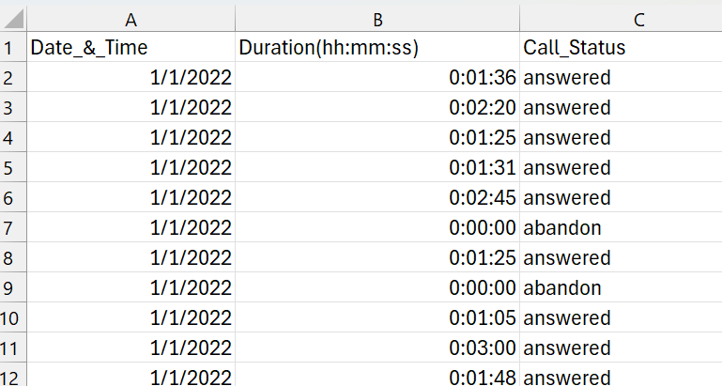
I have taken the Date_&_Time, Duration(hh:mm:ss), Call_Status columns for analysis

Slide 22
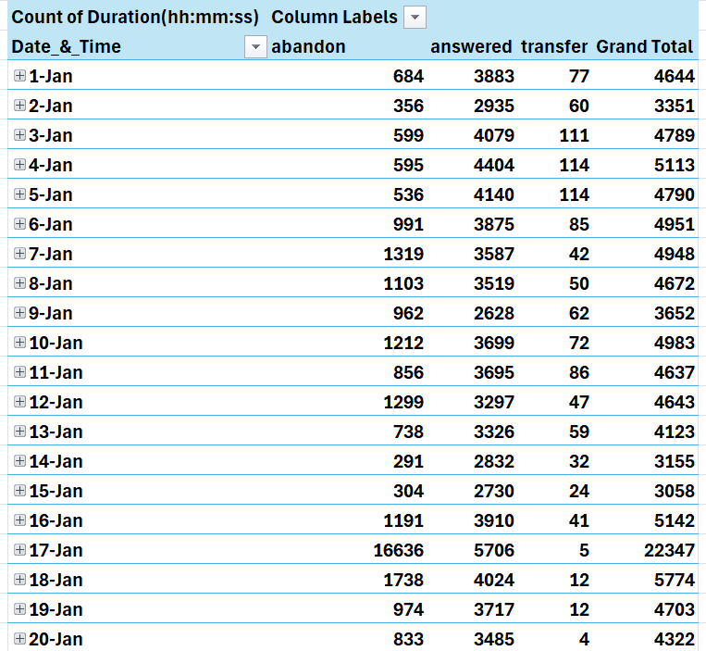
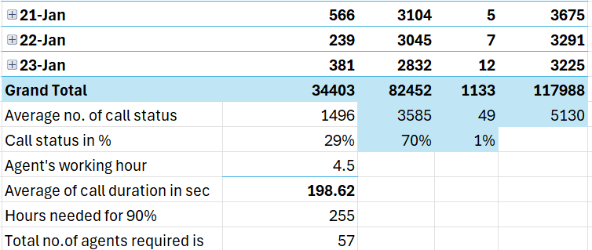
I have created a pivot table using the Date_&_Time, Duration(hh:mm:ss), Call_Status columns

Slide 23
To know the no of calls answered ,abundant and transfer I have used the average function from 6 to 28 cell to find the the average for abandon column
=AVERAGE(I6:I28)
in the same way I have found averages for transfer and answered columns in the pivot table in order to know the call status in percentage I have just divided
The average of abandon by grand total that gives call percentage of abandon as 29%, and the average of answered by grand total that gives the call percentage of answered as 70%, and the average of transfer by grand total that gives the call percentage of transfer as 1%
In order to lower the abandon rate to 10% how many agents must be present in each time bucket at minimum ?
To reduce the abandonment rate to 10%, the minimum number of agents required per time bucket must be determined

Slide 24
The working conditions and schedule of an agent, including:
- Work Schedule: Agents work 6 days a week.
- Leaves: Agents take an average of 4 unscheduled leaves per month.
- Daily Working Hours: Agents have a total working time of 9 hours per day.
- Breaks: 1.5 hours are allocated for lunch and snacks.
Customer Interaction: Agents typically engage with customers for 60% of their working hours.
- Monthly Consideration: The month is considered to have 30 days.
Considering these factors, the goal is to calculate the necessary number of agents per time bucket to ensure that at least 90 out of 100 calls are answered, taking into account the actual time agents spend communicating with customers during their work hours.

Slide 25
The agent works 60 % of 7.5 hours that is
=(60/100)*7.5 = 4.5
Within 7.5 hours they have worked only for 60 % so the actual time period they have worked is 4.5 hours daiy
The average of call seconds which is calculated in task 1 is 198.62
In order to increase the call duration of answered column from 70% to 90%
To find the hours needed for 90%
I have Divided the grand total no of calls received into average call duration in seconds into 0.9 divided by 3600
=L30*I33*0.9/3600
I have divided by 3600 because I want to convert the seconds into hours
Thus the hours needed for 90% is 255 which explains it takes 255 hours taken for workers to get answered rate from 70% to 90%
To find the total no of agents required I have divided the hours needed for 90% into agents working hour which is 57
Thus the answer is to get 90% of the work done we require atleast 57 no of agents to complete the task

Slide 26
The workforce planning and resource allocation for a call center. It states that each agent works six days a week for 7.5 hours a day, with 60% of that time spent answering calls, equating to about 4.5 hours per day on calls. It was determined that approximately 57 agents are needed to ensure coverage and maintain a service level where at least 90 out of 100 calls are answered. This conclusion was reached after calculating the total number of hours required to manage incoming calls across all time periods, which totaled 254.7 hours. The analysis aims to meet call volume expectations and guarantee customer satisfaction.

Slide 27
TO PROPOSE A MANPOWER PLAN FOR EACH TIME BUCKET THROUGHOUT THE DAY KEEPING THE MAXIMUM ABANDON RATE AT 10%
a strategy to maintain a maximum abandonment rate of 10% for call centers. It emphasizes adjusting staffing levels for different time buckets to handle call volumes effectively. the proposed plan includes:
- Daytime (9:00 AM to 9:00 PM): Allocate agents based on current call volume, ensuring
staffing levels meet demand to keep the abandonment rate below 10%.
- Nighttime (9:00 PM to 9:00 AM the next day): Currently, there are no agents available
during these hours, resulting in unanswered calls and poor customer experience. To
address this, consider hiring overnight agents or setting up call forwarding to handle
the additional 30 calls made overnight. Ensure these additional personnel are
equipped to handle inquiries promptly to maintain customer satisfaction.
By implementing this strategy, the goal is to maintain an abandonment rate of 10% across all time periods, ensuring a positive customer experience around the clock.

Slide 28
I have taken the date_&_time, duration(hh:mm:ss), call_status columns for analysis as before in the previous task

Slide 29
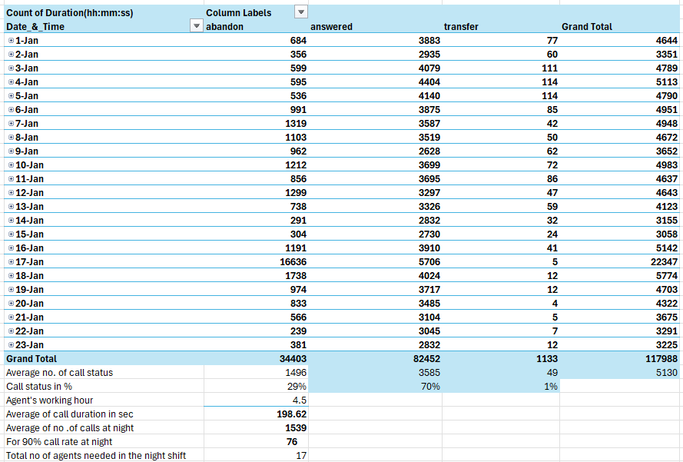
I have taken the same pivot table used in the previous task and I have added night calculations to it

Slide 30
To know the no of calls answered ,abundant and transfer I have used the average function from 6 to 28 cell to find the the average for abandon column
=AVERAGE(I6:I28)
in the same way I have found averages for transfer and answered columns in the pivot table in order to know the call status in percentage I have just divided
The average of abandon by grand total that gives call percentage of abandon as 29%, and the average of answered by grand total that gives the call percentage of answered as 70%, and the average of transfer by grand total that gives the call percentage of transfer as 1%
The agent works 60 % of 7.5 hours that is
=(60/100)*7.5 = 4.5
Within 7.5 hours they have worked only for 60 % so the actual time period they have worked is 4.5 hours daiy
As the same as The average of call seconds which is calculated in task 1 is 198.62

Slide 31
As mentioned there is 30 calls received during the night
So to find the Average of no .of calls at night
The calculation is
=0.3*F30
Which is 30 into grand total of no of calls
Which gives 1539
To find 90% call rate at night
I have divided Average of call duration in sec into Average of no .of calls at night
Which is =C34*C33*0.9/3600
In the above calculation
I have multiplied it by 0.9 to get 90% and divided it by 3600 to get the calculation in hours
Which gives average of no of calls at night as 76
To find the total no of agents needed in the night shift
I have divided 90% call rate at night into Agent's working hour
Which is =C35/C32
Which gives 17
Thus the Total no of agents needed in the night shift is 17 agents

Slide 32
17 agents needed to work during the night shift so that 90 out of 100 calls can be answered during that time and the company profit will be increased and the customer satisfaction will arise
Thus analyzing the need for night shift staffing, estimating that an average of 1,539 calls are made during these hours. To achieve a 90% call rate, approximately 17 agents are required. This approach ensures effective scheduling, sufficient coverage to address call volume needs, and maintains service quality during the night shift.

